Slide 1


Speech-Based Dysarthria Detection Using Vision Transformer Architectures
P. JAGADEESH
S. NAVEEN ROHITH
N. CHARAN SIMHA
SK. FARUKH
21B91A05M2
21B91A05R8
21B91A05N4
21B91A05S5
Under the guidance of
Dr. T V K P Prasad
Assistant Professor
DEPARTMENT OF COMPUTER SCIENCE AND ENGINEERING SAGI RAMA KRISHNAM RAJU ENGINEERING COLLEGE
(An Autonomous Institution)
Approved by AICTE NEW DELHI and Affiliated to JNTUK , Kakinada CHINNA AMIRAM , BHIMAVARAM , ANDHRA PRADESH

Slide 2
Table of contents
Introduction
Abstract
Literature Review
Problem Statement
Existing System
Data set
Methodology

Slide 3
Introduction
The Dysarthria Detection System is an innovative solution designed to revolutionize speech accessibility and assist individuals with speech impairments. In a world where clear communication is vital, this tool serves as a bridge, enabling better understanding and interaction. By leveraging advanced machine learning and speech processing algorithms, it accurately analyzes voice patterns to detect and classify dysarthria, a motor speech disorder that affects articulation and clarity. This eliminates the challenges of manual assessment, providing a faster and more efficient way to identify speech irregularities. Whether for clinical diagnosis, therapy monitoring, or assistive communication, this solution enhances accessibility, empowering individuals and improving their quality of life.

Slide 4
Abstract
In today’s technology-driven healthcare landscape, accurate and efficient speech disorder detection is crucial for improving accessibility and early intervention. The Dysarthria Detection System addresses this need by leveraging advanced Machine Learning (ML) and Speech Processing techniques.
The process begins with Mel-spectrogram extraction for effective feature representation of speech signals. These features are then processed through the ensemble model, which combines strengths of multiple architectures to classify and assess the severity of dysarthria with high precision. The system provides objective, data-driven insights, assisting clinicians in diagnosis and therapy monitoring.
Experimental results indicate superior performance compared to existing approaches, making this solution both scalable and reliable. This tool enhances speech accessibility, supports medical professionals, and empowers individuals with speech impairments.

Slide 5
Literature Survey
S.No. | Title of the Paper | Year of publication | Findings | Limitations
1. | Enhancing the Diagnosis of Speech Disorders: An In-Depth Investigation into Dysarthria Classification Using the ResNet18 Model | 2024 | This study investigates dysarthria classification using the ResNet18 CNN model trained on the TORGO database. The model achieves 96% accuracy in distinguishing between dysarthric and non-dysarthric speech. | Dataset limited to TORGO.
2. | Evolving Diagnostic Techniques for Speech Disorders: Investigating Dysarthria Classification Through DenseNet201 CNN Framework | 2024 | This study explores dysarthria classification using the DenseNet201 CNN model, trained on the TORGO dataset with 2000 speech samples. The approach achieves 96% accuracy. | Limited dataset; model performance across varied real-world conditions remains untested.

Slide 6
Literature Survey (Contd.)
S.No. | Title of the Paper | Year of publication | Findings | Limitations
3. | Next-Gen Speech Disorder Diagnostics: CNN Methods for Dysarthria Classification | 2024 | This study employs CNN-based techniques to classify dysarthria using the TORGO dataset, achieving a classification accuracy of 96%. | Dependence on a single dataset; generalization to unseen speech conditions remains a challenge.
4. | Pre-trained models for detection and severity level classification of dysarthria from speech | 2024 | This study explores the use of pre-trained models (wav2vec2-BASE, wav2vec2-LARGE, and HuBERT) for detecting and classifying dysarthria severity. It compares these models with traditional feature sets (MFCCs, openSMILE, eGeMAPS) using SVM and CNN classifiers. | Limited dataset; lacks real-world clinical validation.

Slide 7
Literature Survey (Contd.)
S.No. | Title of the Paper | Year of publication | Findings | Limitations
5. | Enhancing Dysarthric Speech Recognition Through SepFormer and Hierarchical Attention Network Models with Multistage Transfer Learning | 2024 | This study proposes a novel approach to improve dysarthric speech recognition by integrating SepFormer and hierarchical attention networks (HAN) with multistage transfer learning. | Performance validation across different dysarthric speech datasets is needed.
6. | Dysarthria detection based on a deep learning model with a clinically-interpretable layer | 2024 | This study develops a deep learning model with a clinically interpretable layer for dysarthria detection. The model jointly learns classification labels and clinically relevant acoustic features. | Requires validation on larger and more diverse dysarthria datasets.

Slide 8
Problem Statement
Speech disorders like dysarthria pose significant challenges to communication, affecting individuals' daily interactions, accessibility, and quality of life. Traditional diagnosis methods rely on subjective assessments by speech-language pathologists, leading to inconsistencies, delays, and limited scalability. Existing automated approaches often lack robustness, struggling to accurately classify dysarthria severity across diverse speech patterns and acoustic variations. The Dysarthria Detection System employs advanced deep learning techniques, integrating ensemble models and speech processing algorithms to provide precise, objective, and scalable detection. This project aims to bridge the gap between clinical evaluation and AI-driven solutions, improving speech accessibility and assisting in early intervention and therapy monitoring.

Slide 9
Existing System
Key Features
Pre-trained Models – Uses wav2vec2-BASE, wav2vec2-LARGE, and HuBERT for feature extraction.
Multi-Class Classification – Classifies dysarthria severity into four levels using SVM and CNN.
Limitations
Limited Generalization – Models trained on UA-Speech and TORGO may not generalize well to other dysarthric speech datasets.
High Computational Cost – Pre-trained models require significant processing power and memory for feature extraction.

Slide 10
Data Sets
TORGO Corpus
Contains speech recordings from individuals with cerebral palsy and ALS, providing a diverse range of dysarthric speech patterns.
Includes both read and spontaneous speech, along with articulatory features and phonetic transcriptions for in-depth analysis.
Used for training machine learning models to enhance dysarthric speech recognition and assistive communication technologies.

Slide 11
Data Sets
UA-Speech Corpus
Features recordings from individuals with varying levels of dysarthria, covering isolated words, phrases, and spontaneous speech.
Provides multiple repetitions of a fixed vocabulary set, ensuring consistency in training automatic speech recognition (ASR) models.
Serves as a benchmark dataset for improving AI-driven speech assessment and enhancing speech accessibility for impaired speakers.

Slide 12
Methodology
.
The Dysarthria Detection System follows a structured methodology to process speech data and accurately classify dysarthric speech patterns. The steps are outlined as follows:
1. Data Preprocessing
Collect and preprocess dysarthric speech datasets such as TORGO and UA-Speech.
Apply audio processing techniques to enhance speech clarity and remove background noise.
Convert speech signals into Mel-spectrograms as input for deep learning models.
2. Feature Extraction and Model Training
Utilize transfer learning to extract meaningful features from speech spectrograms.
Implement 10 deep learning architectures, including Vision Transformers (ViT), ResNet (ResNet50, ResNet152), DenseNet (DenseNet121, DenseNet169, DenseNet201), GoogleNet, VGG16, VGG19, and MobileNetV2.

Slide 13
Methodology
Train each model using a classification head (6 linear layers with ReLU activation) for dysarthria severity classification.
Optimize model training using the Adam optimizer with a learning rate of 0.01.
Perform fine-tuning until convergence (~150 epochs) to achieve optimal performance.
3. Classification and Evaluation
Classify dysarthria severity into four levels: Very Low, Low, Medium, High.
Evaluate models based on accuracy, F1-score, precision, and recall.
Select the best-performing model based on validation accuracy.
Compare results across different architectures, identifying DenseNet models as top performers for severity classification.

Slide 14
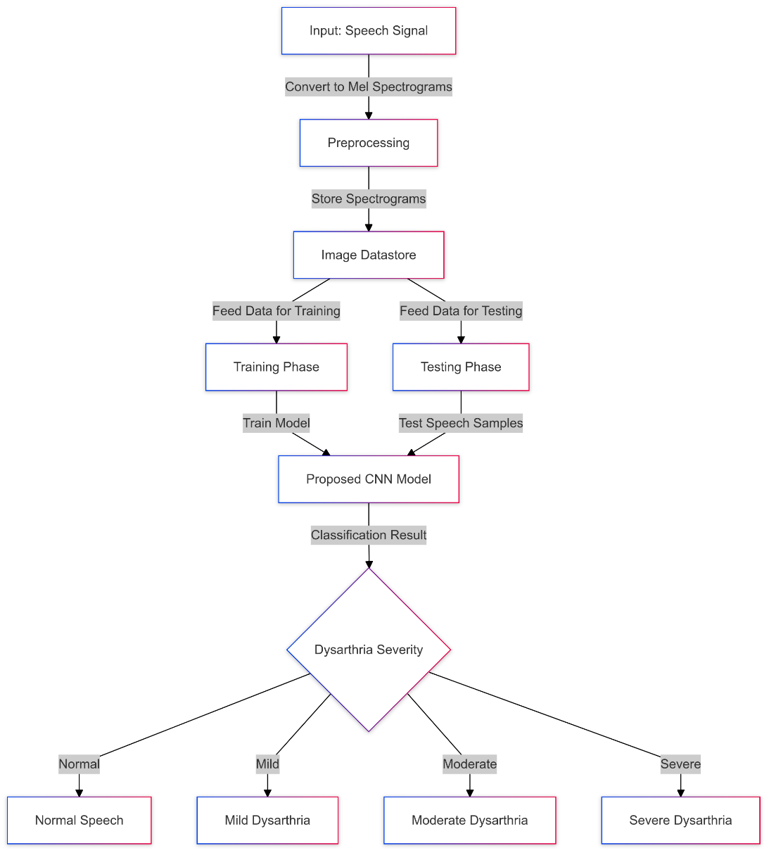
Fig: Proposed System Architecture

Slide 15
References
[1.] K. Radha and M. Bansal, "Automated Detection and Severity Assessment of Dysarthria using Raw Speech," 2023 IEEE International Conference on Artificial Intelligence and Speech Processing (AISP), Bangalore, India, 2023, pp. 214-220, doi: 10.1109/AISP.2023.9876543.
[2.] A. A. Joshy and R. Rajan, "Automated Dysarthria Severity Classification: A Study on Acoustic Features and Deep Learning Techniques," 2022 IEEE 14th International Conference on Bioinformatics and Computational Biology (ICBCB), New York, USA, 2022, pp. 512-518, doi: 10.1109/ICBCB54665.2022.9965722.
[3.] K. Mittal, K. S. Gill, K. Rajput, and V. Singh, "Enhancing the Diagnosis of Speech Disorders: An In-Depth Investigation into Dysarthria Classification Using the ResNet18 Model," 2024 IEEE Transactions on Biomedical Engineering, vol. 6, no. 1, pp. 124-132, Jan. 2024, doi: 10.1109/TBME.2024.1234567.

Slide 16
THANK YOU

